Slide 1
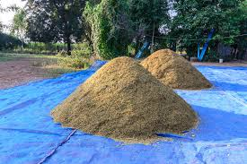


Heaps and Heapsort
Oswald c
Invented by J. W. J. Williams in 1964
The class notes are a compilation and edition from many sources. The faculty does not claim intellectual property or ownership of the lecture notes.

Slide 2
Special Types of Trees
Def: Full binary tree = a binary tree in which each node is either a leaf or has exactly 2 children.
Def: Complete binary tree = a binary tree in which all leaves are on the same level and all internal nodes have 2 children.
4
1
3
2
16
9
10
14
8
7
12
Full binary tree
4
1
3
2
16
9
10
Complete binary tree

Slide 3
Definitions
Height of a node = the number of edges on the longest simple path from the node down to a leaf
Level of a node = the length of a path from the root to the node
Height of tree = height of root node
4
Height of root = 3
1
3
Height of (2)= 1
2
16
9
10
Level of (10)= 2
14
8

Slide 4
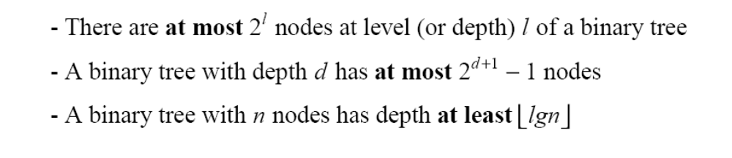
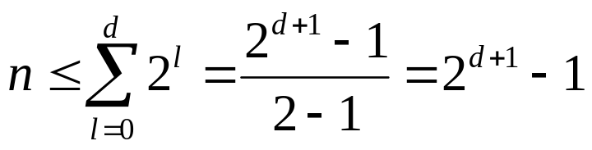
Useful Properties
height
height
(see Ex 6.1-2, page 129)
4
Height of root = 3
1
3
Height of (2)= 1
2
16
9
10
Level of (10)= 2
14
8

Slide 5
The Heap Data Structure
Invented by J. W. J. Williams in 1964
Def: A heap is a nearly complete binary tree with the following two properties:
  Structural property: all levels are full, except possibly the last one, which is filled from left to right
  Order (heap) property: for any node x
  Parent(x) ≥ x
From the heap property, it follows that:
“The root is the maximum
element of the heap!”
8
7
4
5
2
Heap
A heap is a binary tree that is filled in order

Slide 6
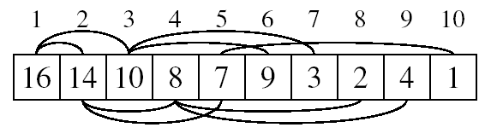
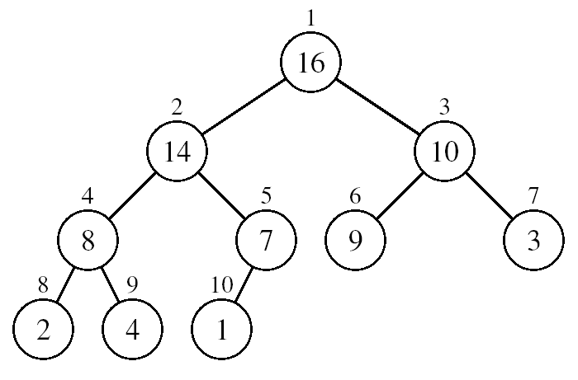
Array Representation of Heaps
A heap can be stored as an array A.
  Root of tree is A[1]
  Left child of A[i] = A[2i]
  Right child of A[i] = A[2i + 1]
  Parent of A[i] = A[ ⎣i/2⎦ ]
  Heapsize[A] ≤ length[A]
The elements in the subarray A[(⎣n/2⎦+1) .. n] are leaves

Slide 7
Heap Types
Max-heaps (largest element at root), have the max-heap property:
  for all nodes i, excluding the root:
  A[PARENT(i)] ≥ A[i]
Min-heaps (smallest element at root), have the min-heap property:
  for all nodes i, excluding the root:
  A[PARENT(i)] ≤ A[i]

Slide 8
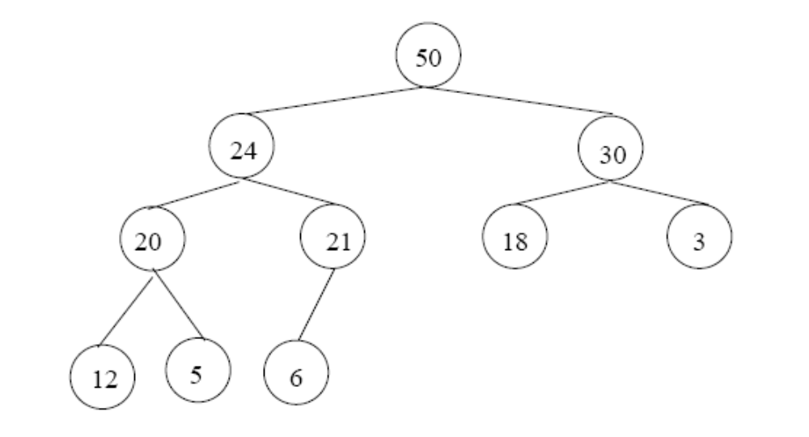
Adding/Deleting Nodes
New nodes are always inserted at the bottom level (left to right)
Nodes are removed from the bottom level (right to left)

Slide 9
Operations on Heaps
Maintain/Restore the max-heap property
  MAX-HEAPIFY
Create a max-heap from an unordered array
  BUILD-MAX-HEAP
Sort an array in place
  HEAPSORT
Priority queues

Slide 10
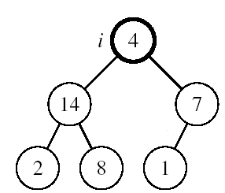
Maintaining the Heap Property
Suppose a node is smaller than a child
  Left and Right subtrees of i are max-heaps
To eliminate the violation:
  Exchange with larger child
  Move down the tree
  Continue until node is not smaller than children

Slide 11
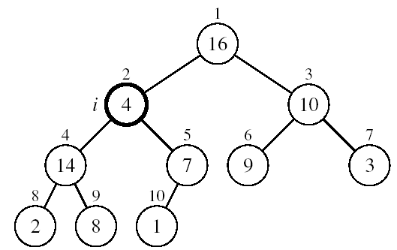
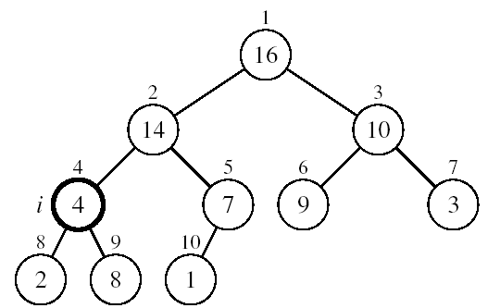
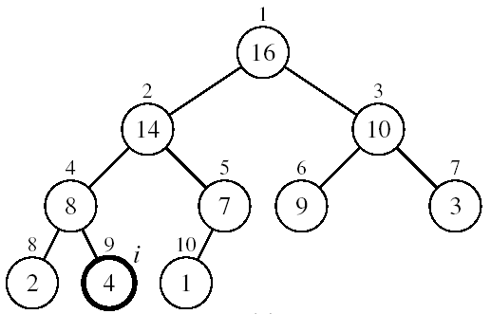
Example
MAX-HEAPIFY(A, 2, 10)
A[2] ↔ A[4]
A[2] violates the heap property
A[4] violates the heap property
A[4] ↔ A[9]
Heap property restored

Slide 12
Maintaining the Heap Property
Alg: MAX-HEAPIFY(A, i, n)
l ← LEFT(i)
r ← RIGHT(i)
if l ≤ n and A[l] > A[i]
then largest ←l
else largest ←i
if r ≤ n and A[r] > A[largest]
then largest ←r
if largest ≠ i
then exchange A[i] ↔ A[largest]
MAX-HEAPIFY(A, largest, n)
Assumptions:
  Left and Right subtrees of i are max-heaps
  A[i] may be smaller than its children

Slide 13
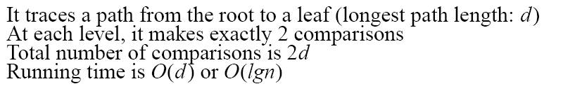
MAX-HEAPIFY Running Time
Intuitively:
Running time of MAX-HEAPIFY is O(lgn)
Can be written in terms of the height of the heap, as being O(h)
  Since the height of the heap is ⎣lgn⎦
-
h
-
-
-
2h
O(h)

Slide 14
Building a Heap
Convert an array A[1 … n] into a max-heap (n = length[A])
The elements in the subarray A[(⎣n/2⎦+1) .. n] are leaves
Apply MAX-HEAPIFY on elements between 1 and ⎣n/2⎦
Alg: BUILD-MAX-HEAP(A)
n = length[A]
for i ← ⎣n/2⎦ downto 1
do MAX-HEAPIFY(A, i, n)
1
4
2
3
1
3
4
5
6
7
2
16
9
10
8
9
10
14
8
7
A:
4 | 1 | 3 | 2 | 16 | 9 | 10 | 14 | 8 | 7

Slide 15
Method 1: A
4 | 1 | 3 | 2 | 16 | 9 | 10 | 14 | 8 | 7
i = 5
i = 4
i = 3
1
1
1
4
4
4
2
3
2
3
2
3
1
3
1
3
1
3
4
5
6
7
4
5
6
7
4
5
6
7
2
16
9
10
2
16
9
10
14
16
9
10
8
9
10
8
9
10
8
9
10
14
8
7
14
8
7
2
8
7
i = 2
i = 1
1
1
1
4
4
16
2
3
2
3
2
3
1
10
16
10
14
10
4
5
6
7
4
5
6
7
4
5
6
7
14
16
9
3
14
7
9
3
8
7
9
3
8
9
10
8
9
10
8
9
10
2
8
7
2
8
1
2
4
1

Slide 16
Constructing a heap – Method II
8
8
10
10
10
8
8
5
1
2
3
10
10
12
8
5
12
5
10
5
12
8
8
4

Slide 17
Running Time of BUILD MAX HEAP
Alg: BUILD-MAX-HEAP(A)
n = length[A]
for i ← ⎣n/2⎦ downto 1
do MAX-HEAPIFY(A, i, n)
O(n)
O(lgn)
⇒ Running time: O(nlgn)
This is not an asymptotically tight upper bound

Slide 18
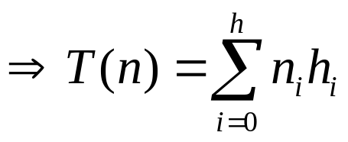
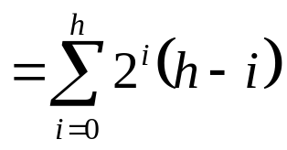

Running Time of BUILD MAX HEAP
HEAPIFY takes O(h) ⇒ the cost of HEAPIFY on a node i is proportional to the height of the node i in the tree
Height
Level
No. of nodes
h₀ = 3 (⎣lgn⎦)
i = 0
2⁰
h₁ = 2
i = 1
2¹
h₂ = 1
i = 2
2²
h₃ = 0
i = 3 (⎣lgn⎦)
2³
h_{i} = h – i height of the heap rooted at level i
n_{i} = 2^{i} number of nodes at level i

Slide 19
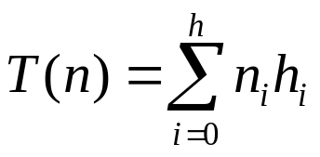
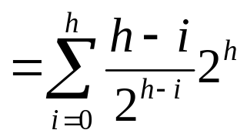

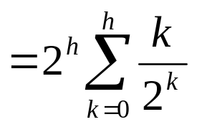
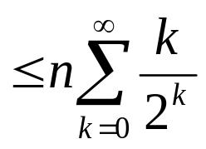
Running Time of BUILD MAX HEAP
Cost of HEAPIFY at level i ∗ number of nodes at that level
Replace the values of n_{i} and h_{i} computed before
Multiply by 2^{h} both at the nominator and denominator and
write 2^{i} as
Change variables: k = h - i
The sum above is smaller than the sum of all elements to ∞
and h = lgn
The sum above is smaller than 2
Running time of BUILD-MAX-HEAP: T(n) = O(n)

Slide 20
Applications of Heaps
Heapsort
Selection algorithms
Graph algorithms
Priority Queue
K-way merge
Order statistics

Slide 21



Slide 22
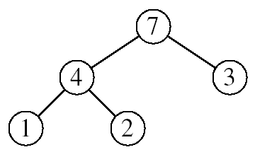
Heapsort
Goal:
  Sort an array using heap representations
Idea:
  Build a max-heap from the array
  Swap the root (the maximum element) with the last element in the array
  “Discard” this last node by decreasing the heap size
  Call MAX-HEAPIFY on the new root
  Repeat this process until only one node remains
To sort the elements in the decreasing order, use a min heap
To sort the elements in the increasing order, use a max heap

Slide 23
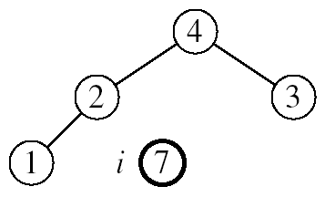
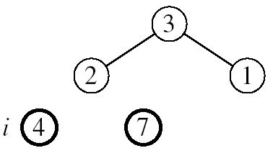
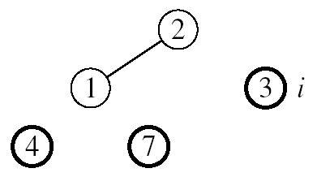
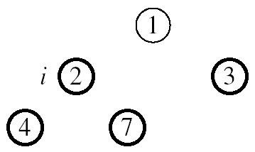

Example 1: A=[7, 4, 3, 1, 2]
MAX-HEAPIFY(A, 1, 4)
MAX-HEAPIFY(A, 1, 3)
MAX-HEAPIFY(A, 1, 2)
MAX-HEAPIFY(A, 1, 1)

Slide 24
Example 2:
Take out biggest
19
12
16
Move the last element
to the root
1
4
7
Sorted:
Array A
12
16
1
4
7
19

Slide 25
7
swap
HEAPIFY()
12
16
1
4
Sorted:
Array A
7
12
16
1
4
19

Slide 26
16
12
7
1
4
Sorted:
Array A
16
12
7
1
4
19

Slide 27
Take out biggest
16
Move the last element
to the root
12
7
1
4
Sorted:
Array A
12
7
1
4
16
19

Slide 28
4
12
7
1
Sorted:
Array A
4
12
7
1
16
19

Slide 29
swap
4
HEAPIFY()
12
7
1
Sorted:
Array A
4
12
7
1
16
19

Slide 30
12
4
7
1
Sorted:
Array A
12
4
7
1
16
19

Slide 31
Take out biggest
12
Move the last
element to the
root
4
7
1
Sorted:
Array A
4
7
1
12
16
19

Slide 32
1
swap
4
7
Sorted:
Array A
1
4
7
12
16
19

Slide 33
7
4
1
Sorted:
Array A
7
4
1
12
16
19

Slide 34
Take out biggest
7
Move the last
element to the
root
4
1
Sorted:
Array A
1
4
7
12
16
19

Slide 35
swap
1
HEAPIFY()
4
Sorted:
Array A
4
1
7
12
16
19

Slide 36
Take out biggest
Move the last
element to the
root
4
1
Sorted:
Array A
1
4
7
12
16
19

Slide 37
Take out biggest
1
Sorted:
Array A
1
4
7
12
16
19

Slide 38
Sorted:
1
4
7
12
16
19

Slide 39
Alg: HEAPSORT(A)
BUILD-MAX-HEAP(A)
for i ← length[A] downto 2
do exchange A[1] ↔ A[i]
MAX-HEAPIFY(A, 1, i - 1)
Running time: O(nlgn) --- Can be shown to be Θ(nlgn)
O(n)
n-1 times
O(lgn)

Slide 40
Analysis I
Here’s how the algorithm starts:
    heapify the array;
Heapifying the array: we add each of n nodes
  Each node has to be shifted up, possibly as far as the root
    Since the binary tree is perfectly balanced, sifting up a single node takes O(log n) time
  Since we do this n times, heapifying takes n*O(log n) time, that is, O(n log n) time

Slide 41
Analysis II
Here’s the rest of the algorithm:
    while the array isn’t empty {
    remove and replace the root;
    reheap the new root node;
    }
We do the while loop n times (actually, n-1 times), because we remove one of the n nodes each time
Removing and replacing the root takes O(1) time
Therefore, the total time is n times however long it takes the reheap method

Slide 42
Analysis III
To reheap the root node, we have to follow one path from the root to a leaf node (and we might stop before we reach a leaf)
The binary tree is perfectly balanced
Therefore, this path is O(log n) long
  And we only do O(1) operations at each node
  Therefore, reheaping takes O(log n) times
Since we reheap inside a while loop that we do n times, the total time for the while loop is n*O(log n), or O(n log n)

Slide 43
Analysis IV
Here’s the algorithm again:
    heapify the array;
    while the array isn’t empty {
    remove and replace the root;
    reheap the new root node;
    }
We have seen that heapifying takes O(n log n) time
The while loop takes O(n log n) time
The total time is therefore O(n log n) + O(n log n)
This is the same as O(n log n) time

Slide 44
Comparison with Quick Sort and Merge Sort
Quick sort is typically somewhat faster, due to better cache behavior and other factors, but the worst-case running time for quick sort is O (n²), which is unacceptable for large data sets and can be deliberately triggered given enough knowledge of the implementation, creating a security risk.
The quick sort algorithm also requires Ω (log n) extra storage space, making it not a strictly in-place algorithm. This typically does not pose a problem except on the smallest embedded systems, or on systems where memory allocation is highly restricted. Constant space (in-place) variants of quick sort are possible to construct, but are rarely used in practice due to their extra complexity.

Slide 45
Comparison with Quick Sort and Merge Sort (cont)
Thus, because of the O(n log n) upper bound on heap sort’s running time and constant upper bound on its auxiliary storage, embedded systems with real-time constraints or systems concerned with security often use heap sort.
Heap sort also competes with merge sort, which has the same time bounds, but requires Ω(n) auxiliary space, whereas heap sort requires only a constant amount. Heap sort also typically runs more quickly in practice. However, merge sort is simpler to understand than heap sort, is a stable sort, parallelizes better, and can be easily adapted to operate on linked lists and very large lists stored on slow-to-access media such as disk storage or network attached storage. Heap sort shares none of these benefits; in particular, it relies strongly on random access.

Slide 46
Possible Application
  When we want to know the task that carry the highest priority given a large number of things to do
  Interval scheduling, when we have a lists of certain task with start and finish times and we want to do as many tasks as possible
  Sorting a list of elements that needs and efficient sorting algorithm

Slide 47
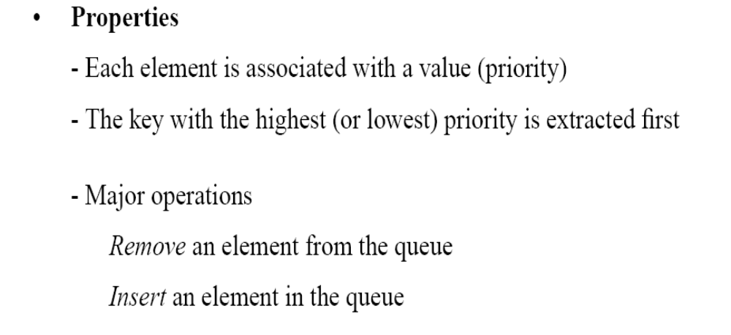
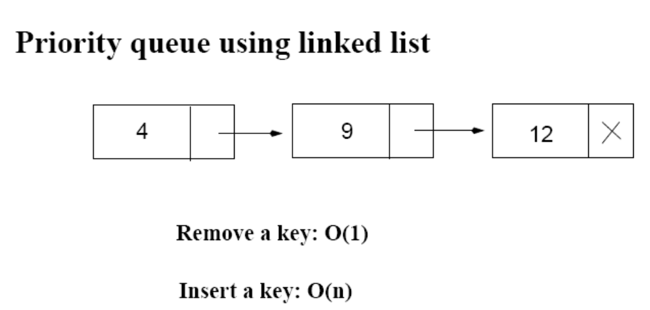
Priority Queues
12
4

Slide 48
Operations on Priority Queues
Max-priority queues support the following operations:
  INSERT(S, x): inserts element x into set S
  EXTRACT-MAX(S): removes and returns element of S with largest key
  MAXIMUM(S): returns element of S with largest key
  INCREASE-KEY(S, x, k): increases value of element x’s key to k (Assume k ≥ x’s current key value)

Slide 49
HEAP-MAXIMUM
Goal:
  Return the largest element of the heap
Alg: HEAP-MAXIMUM(A)
return A[1]
Running time: O(1)
Heap A:
Heap-Maximum(A) returns 7

Slide 50
HEAP-EXTRACT-MAX
Goal:
  Extract the largest element of the heap (i.e., return the max value and also remove that element from the heap
Idea:
  Exchange the root element with the last
  Decrease the size of the heap by 1 element
  Call MAX-HEAPIFY on the new root, on a heap of size n-1
Heap A:
Root is the largest element

Slide 51
Example: HEAP-EXTRACT-MAX
16
1
14
10
max = 16
14
10
8
7
9
3
8
7
9
3
2
4
1
2
4
Heap size decreased with 1
14
Call MAX-HEAPIFY(A, 1, n-1)
8
10
4
7
9
3
2
1

Slide 52
HEAP-EXTRACT-MAX
Alg: HEAP-EXTRACT-MAX(A, n)
if n < 1
then error “heap underflow”
max ← A[1]
A[1] ← A[n]
MAX-HEAPIFY(A, 1, n-1) remakes heap
return max
Running time: O(lgn)

Slide 53
HEAP-INCREASE-KEY
Goal:
  Increases the key of an element i in the heap
Idea:
  Increment the key of A[i] to its new value
  If the max-heap property does not hold anymore: traverse a path toward the root to find the proper place for the newly increased key
16
14
10
8
i
7
9
3
Key [i] ← 15
2
4
1

Slide 54
Example: HEAP-INCREASE-KEY
16
16
14
10
14
10
8
i
7
9
3
8
i
7
9
3
2
4
1
2
15
1
Key [i ] ← 15
16
16
i
14
10
15
10
i
15
7
9
3
14
7
9
3
2
8
1
2
8
1

Slide 55
HEAP-INCREASE-KEY
Alg: HEAP-INCREASE-KEY(A, i, key)
if key < A[i]
then error “new key is smaller than current key”
A[i] ← key
while i > 1 and A[PARENT(i)] < A[i]
do exchange A[i] ↔ A[PARENT(i)]
i ← PARENT(i)
Running time: O(lgn)
16
14
10
8
i
7
9
3
2
4
1
Key [i] ← 15

Slide 56
MAX-HEAP-INSERT
Goal:
  Inserts a new element into a max-heap
Idea:
  Expand the max-heap with a new element whose key is -∞
  Calls HEAP-INCREASE-KEY to set the key of the new node to its correct value and maintain the max-heap property
16
14
10
8
7
9
3
2
4
1
-∞
16
14
10
8
7
9
3
2
4
1
15

Slide 57
Example: MAX-HEAP-INSERT
Insert value 15:
- Start by inserting -∞
Increase the key to 15
Call HEAP-INCREASE-KEY on A[11] = 15
16
16
14
10
14
10
8
7
9
3
8
7
9
3
2
4
1
-∞
2
4
1
15
The restored heap containing
the newly added element
16
16
14
10
15
10
8
15
9
3
8
14
9
3
2
4
1
7
2
4
1
7

Slide 58
MAX-HEAP-INSERT
Alg: MAX-HEAP-INSERT(A, key, n)
heap-size[A] ← n + 1
A[n + 1] ← -∞
HEAP-INCREASE-KEY(A, n + 1, key)
16
14
10
8
7
9
3
2
4
1
-∞
Running time: O(lgn)

Slide 59
Summary
We can perform the following operations on heaps:
  MAX-HEAPIFY O(lgn)
  BUILD-MAX-HEAP O(n)
  HEAP-SORT O(nlgn)
  MAX-HEAP-INSERT O(lgn)
  HEAP-EXTRACT-MAX O(lgn)
  HEAP-INCREASE-KEY O(lgn)
  HEAP-MAXIMUM O(1)
Average
O(lgn)

Slide 60
Priority Queue Using Linked List
12
4
Average: O(n)
Increase key: O(n)
Extract max key: O(1)

Slide 61
Problems
Assuming the data in a max-heap are distinct, what are the possible locations of the second-largest element?

Slide 62
Problems
(a) What is the maximum number of nodes in a max heap of height h?
(b) What is the maximum number of leaves?
(c) What is the maximum number of internal nodes?

Slide 63
Problems
Demonstrate, step by step, the operation of Build-Heap on the array
A=[5, 3, 17, 10, 84, 19, 6, 22, 9]

Slide 64
Problems
Let A be a heap of size n. Give the most efficient algorithm for the following tasks:
Find the sum of all elements
Find the sum of the largest lgn elements

